Slide 1

FRANC3D Training Workshop: Part VI
April - 2018
Drs. Paul “Wash” Wawrzynek, Bruce Carter, Tony Ingraffea and Omar Ibrahim
Fracture Analysis
Consultants, Inc.

Slide 2
Workshop Agenda
Part I: Introduction to Fracture Mechanics Analysis
Part II: Introduction to FRANC3D
Part III: Finite Element (FE) Model Import
Part IV: Crack Insertion
Part V: Static Crack Analysis & SIF Computation
Part VI: SIFs from FE Analysis
Part VII: Crack Growth
Part VIII: Multiple/Variable DOF Approach to Fatigue Life
Part IX: SIF History & Fatigue Life
Part X: FRANC3D Files, Session Log, Command Line and Python Interface
Part XI: Miscellaneous

Slide 3
Linear Elastic Fracture Mechanics Analysis
Using Finite Element Analysis

Slide 4
LEFM Using FEM
Finite element method is a natural tool for performing LEFM problems
A number of researchers investigated special finite element formulations that incorporate singular basis functions or stress intensity factors as nodal variables
  These special elements are not available in most general-purpose finite element programs
Finite Element Method (FEM) needs to be manipulated to handle the singular crack-tip stress and strain fields predicted by the theory

Slide 5
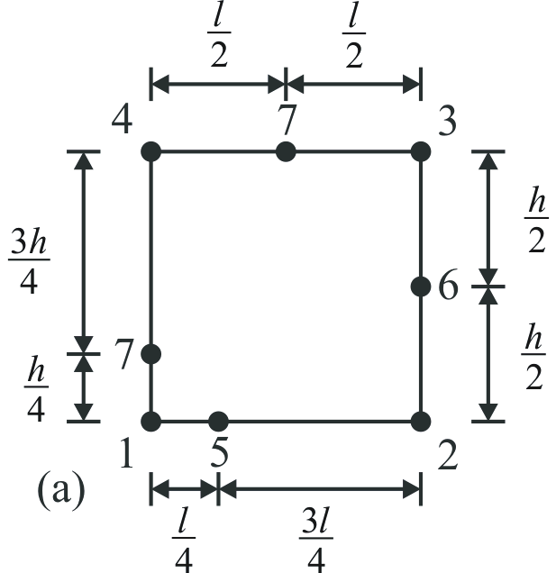
LEFM Using FEM
A significant advancement in the use of the finite element method for LEFM problems was the simultaneous, and independent, development of "quarter-point Element" .
Henshell and Shaw, 1975
Barsoum, 1976
8
Quadrilateral (a) and collapsed quadrilateral (b) quarter-point elements

Slide 6
LEFM Using FEM
These researchers showed that the proper crack-tip displacement, stress, and strain fields are modeled by standard quadratic order isoparametric finite elements if one simply moves the element's mid-side node to the position one quarter of the way from the crack tip to the far end of the element.
  Introduces a singularity into the mapping between the element's parametric coordinate space and Cartesian space.

Slide 7
LEFM Using FEM
The discovery of quarter-point elements was a significant milestone in the development of finite element procedures for LEFM
With these elements standard and widely available, finite element programs can be used to model crack tip fields accurately with only minimal preprocessing required

Slide 8
1D ¼-Point Singular Element
1
3
2
A quadratic element, (a) the parametric space of the element, (b) the Cartesian space of the element. The crack tip is at r=0.
Its standard, polynomial displacement interpolation scheme, above, regrouped, below.
Notes:
8

Slide 9
1D ¼-Point Singular Element
1
3
2
Its standard, polynomial geometry interpolation scheme.
First, the usual case of mid-side geometry:
Then we get the expected, polynomial interpolation:
Notes:
9

Slide 10
1D ¼-Point Singular Element
1
3
2
Its standard, polynomial geometry interpolation scheme.
Next, the unusual case of ¼-point geometry:
Then we get the unexpected, non-polynomial interpolation !!!:
Notes:
10

Slide 11
1D ¼-Point Singular Element
Normal displacement field:
¼-Point displacement field:
Compare to theoretical field:
Normal strain field:
¼-point strain field:
Compare to theoretical field:
Notes:
11

Slide 12
1D ¼-Point Singular Element
Displacement field:
  Contains a constant value, a linear variation in r, and the square root variation in r.
  Corresponds to the leading terms in the LEFM expressions for the near crack-tip displacement.
Strain field:
  Contains a constant term and a singular term that varies as r^{-1/2}
  Corresponds to the lead term in the LEFM stress and strain expansions

Slide 13
3D ¼-Point Singular Elements
(a) collapsed, 20-noded brick, quarter-point element
(b) natural 15-noded, wedge quarter-point element
Notes:
13

Slide 14
Stress Intensity Factors

Slide 15
Stress Intensity Factors
SIF's are a measure of the intensity of the stress concentration along a crack front
Range in the SIF due to cyclic loading can be correlated with the crack growth rate
SIF's are functions of the crack size and shape, local geometry of the component, and local stresses in the crack region

Slide 16
Stress Intensity Factors
FRANC3D was developed primarily to calculate highly accurate SIF's for arbitrarily shaped cracks in arbitrarily shaped components subjected arbitrary loading
FRANC3D handles real-world conditions such as non-planar cracks, cracks with complex shapes, complex component geometries, contact between components, residual stresses, and local stress concentrations

Slide 17
Stress Intensity Factors
FRANC3D computes stress intensity factors for all three “modes” of fracture at FE mid-side nodes along crack front
Under conditions of small-scale yielding, crack behavior controlled by stress intensity factors:
  Stability – will the crack tip move?
  Trajectory – in what direction?
  Rate – how fast?
Notes:
17

Slide 18
Computing Stress Intensity Factors
FRANC3D has two methods of computing stress intensity factors (SIF’s or K’s):
  Displacement Correlation Method
  Conservative Integral Method
    J-Integral
    M-Integral

Slide 19
Displacement Correlation Methods
Relatively simple to understand and implement
Relatively poor accuracy (~5% error for a reasonable mesh)
Good sanity check but not for production work

Slide 20
Theoretical asymptotic displacement fields
, v
, u
Note: for plane stress, let ν = ν/(1+ ν)
Set r = r_{a-b}, and θ = 180°

Slide 21
Displacement Correlation (No Crack-Front Template)
For plane strain case:
r_{a-b}
μ is the shear modulus, ν is Poisson's ratio, r is the distance from the crack tip to the correlation point, and u_{i}, v_{i}, w_{i} are the x, y, and z displacements at point i
Same expressions used for plane stress assumptions if ν is replaced by ν / (1+ν)

Slide 22
Displacement Correlation Methods
SIF's computed by this approach can be improved if quarter-point crack-tip elements are used
Displacement field:
The FEM crack opening displacement (COD) is

Slide 23
Displacement Correlation (With Crack-Front Template)
The square root term of the FEM COD can then be substituted into the analytical crack-tip displacement field to yield

Slide 24
Conservative Integral Methods
M- & J-Integrals

Slide 25
J-Integral
In linear Elastic Fracture Mechanics, LEFM, the J-integral is equivalent to the fracture energy release rate, G.

Slide 26
Energy Release Rate, G
G can be computed either:
  Using the stress intensity factors and material properties and the theoretical expressions for near crack-front displacements and stresses
  OR
  Using the near-crack-front stresses, strains and displacement determined from a finite element analysis (domain integration)

Slide 27
G Computation Using the Stress Intensity Factors and Material Properties

Slide 28
Energy Release Rate Expression Using SIFs & Material Properties
Given the following crack-front coordinate systems (Rectangular and Polar coordinate systems)
The crack-tip energy release rates can be determined from Irwin’s* crack closure integral
(1)
Where σ(r,θ) are the near crack-front stresses (in cylindrical coordinates), and u(r,θ) are the near crack-front displacements
* Irwin, G.R. (1957) Analysis of stresses and strains near the end of a crack traversing a plate, Journal of Applied Mechanics, 24, 361-364

Slide 29
Energy Release Rate Expression Using SIFs & Material Properties
The first term first term of Williams* expansion for the stresses and displacements near the crack tip is related to the stress intensity factors, and gives the following expression for stress and displacement assuming plane strain conditions.
(2)
(3)
* Williams, M.L. (1957) On the stress distribution at the base of a stationary crack, Journal of Applied Mechanics, 24, 109-114

Slide 30
Energy Release Rate Expression Using SIFs & Material Properties
Substituting θ = 0 into equation 2, and θ = π gives
(4)
Substituting equations 4 into 1, and evaluating the integral gives the well know result
(5)
The energy release rate in terms of stress intensity factors and material properties

Slide 31
G Computation Using the near-crack-front stresses, strains and displacement (domain integration)

Slide 32
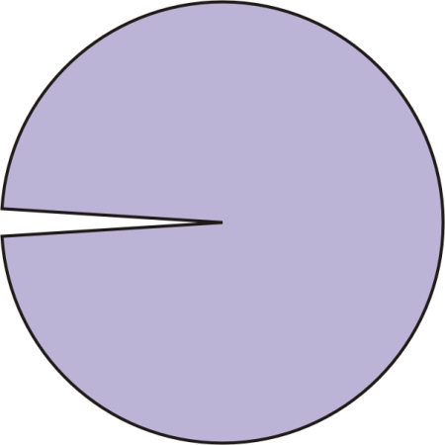
2D Crack-Tip Energy Balance (J-integral)
energy
a
contour
informally:
0
small

Slide 33
Energy Release Rate Expressed Using Near-Crack-front Stresses, Stains and Displacements
The J-Integral* measures energy flux into the crack-tip region
Under conditions of small scale yielding, J-Integral is equal to energy release rate, G
The contour J-Integral can be recast as an equivalent area (volume in 3D) integral**, which is more accurate and stable in a finite element context
(6)
q is a function that is one at the crack tip and zero on the boundary of the integration domain. It can be interpreted as a virtual crack extension, and δ is the Kronecker delta
* Rice, J.R. (1968) A path independent integral and approximate analysis of strain concentrations by notches and cracks, Journal of Applied Mechanics, 35, 379-386
** Li, F.Z., Shih, C.F., and Needleman, A. (1985) A comparison of methods for calculating energy release rates, Engineering Fracture Mechanics, 21, 405-421

Slide 34
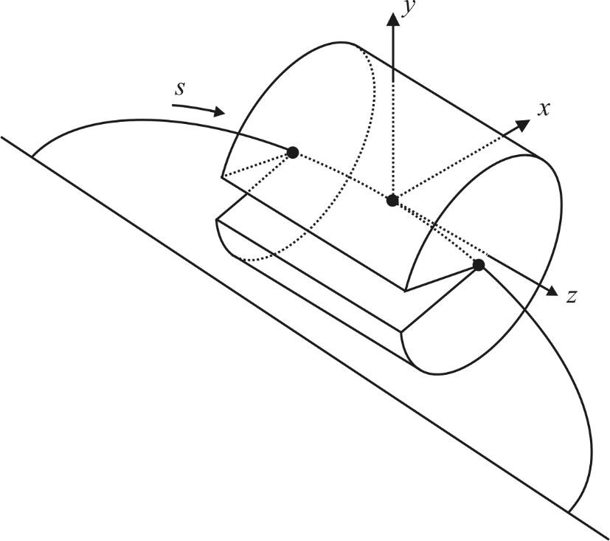
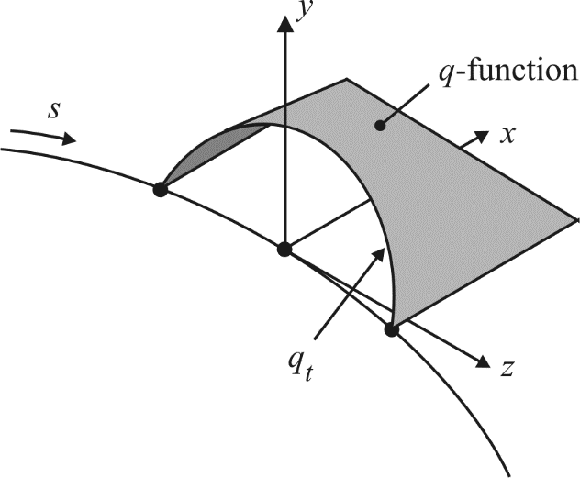
Energy Release Rate Expressed Using Near-Crack-front Stresses, Stains and Displacements
In 3D, the J-Integral is evaluated within a cylindrical domain centered on a portion of the crack-front.
q-function – comparable to a virtual crack extension
J’ is the energy release for the specified virtual crack extension q. This must be normalized to get the energy released for a unit amount of new crack area
(7)
This is an expression for the energy release rate in terms of stresses, strains, and displacements

Slide 35
J-Integral
The problem with J is that it only gives one number for the fracture energy release rate
  Difficult to segregate the fracture energy release rate among the three modes of fracture.

Slide 36
M-Integral

Slide 37
Computing Stress Intensity Factors
M-Integral (Interaction Integral):
Numerically M-Integral similar to J-Integral
M-Integral computes strain energy release energy rates (G_{I}, G_{II}, G_{III}) and stress intensity factors (K_{I}, K_{II}, K_{III}) associated with three modes of fracture
  Mode II (K_{II}) needed to predict kink angle for crack growth direction
M-integral implementation in FRANC3D works for isotropic and anisotropic materials
Relatively good accuracy (<1% error for a reasonable mesh)
Requires additional terms for crack face tractions, residual stresses, thermal strains, etc.
¹ Wawrzynek, P.A., Carter, B., and Banks-Sills, L. “The M-integral for computing stress intensity factors in generally anisotropic materials,” NASA/CR-2005-214006. July 2005
² Banks-Sills, L., Wawrzynek, P.A., Carter, B., Ingraffea, T.R., and Hershkovitz, I., “Methods for computing stress intensity factors in anisotropic geometries: Part II – arbitrary geometry,” Engng. Fracture Mech, Vol 74, No 8, pp 1293-1307. July 2006
Notes:
37

Slide 38
Steps for Formulating the M-Integral
Step(1): Invoke superposition to combine the finite element solution with a know analytical solution
Step(2): Substitute the superposition terms into the energy release rate (G) equations (5) and (7) from the previous slides
Step(3): Equate the two expressions for G and substitute a simple analytical K_{I} solution, and solve for the finite element K_{I}
Step (4): Repeat step (3) for K_{II} and K_{III}
Notes:
38

Slide 39
Principal of Superposition
The principal of superposition for elasticity says that if you have one solution that satisfies the governing equations for elasticity, and you add it to a second solution that satisfies the governing, the result will also satisfy the governing equations
Therefore,
(8)
(9)
where the (1) solution will be the finite element results, and the (2) will be an analytical solution
Notes:
39

Slide 40
Substitution in The Energy Release Rate Equations
Substituting equation (8) into equation (5) (energy release rate in terms of stress intensity factors and material properties), and collecting terms gives
(10)
where
(11)
Notes:
40

Slide 41
Substitution in The Energy Release Rate Equations
Substituting equation (9) into equation (7) (energy release rate in terms of the near-crack-front stresses, strains and displacements), and collecting terms gives
(12)
Where in this case
(13)
Notes:
41

Slide 42
Solving for The Finite Element
For the (2) solution, we use the first term of the Williams expansion, (equations 2 and 3) after setting K_{I} = 1 and K_{II} = K_{III} = 0. Substituting this into equation 11 and 13, and setting the two expressions for M equal to each other, gives
(14)
Or, the finite element K_{I} is
(15)
Where σ⁽¹⁾ and u⁽¹⁾ come from finite element results, and σ⁽²⁾ and u⁽²⁾ are
Notes:
42

Slide 43
Solving for The Finite Element
(16)
and
(17)
(these come from equations 2 and 3 with K_{I} = 1 and K_{II} = K_{III} = 0)
Notes:
43

Slide 44
Solving for The Finite Element
For the (2) solution, we use the first term of the Williams expansion, (equations 2 and 3) after setting K_{I} = 0, K_{II} = 1 and K_{III} = 0. Substituting this into equation 11 and 13, and setting the two expressions for M equal to each other, the finite element K_{II} is
(18)
Where σ⁽¹⁾ and u⁽¹⁾ come from finite element results, and σ⁽²⁾ and u⁽²⁾ are
Notes:
44

Slide 45
Solving for The Finite Element
(19)
and
(20)
(these come from equations 2 and 3 with K_{I} = 0, K_{II} = 1 and K_{III} = 0)
Notes:
45

Slide 46
Solving for The Finite Element
For the (2) solution, we use the first term of the Williams expansion, (equations 2 and 3) after setting K_{I} = K_{II} = 0 and K_{III} = 1. Substituting this into equation 11 and 13, and setting the two expressions for M equal to each other, the finite element K_{III} is
(21)
Where σ⁽¹⁾ and u⁽¹⁾ come from finite element results, and σ⁽²⁾ and u⁽²⁾ are
Notes:
46

Slide 47
Solving for The Finite Element
(22)
(these come from equations 2 and 3 with K_{I} = 0, K_{II} = 0 and K_{III} = 1)
Notes:
47

Slide 48
FRANC3D Uses M-integral by Default

Slide 49
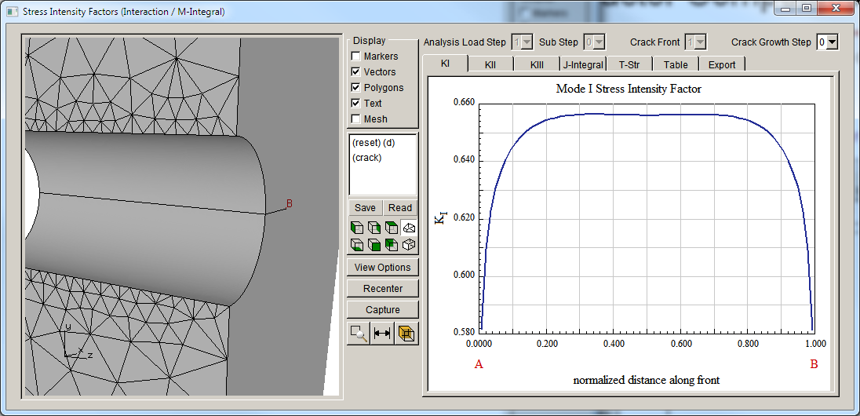
Stress Intensity Factor Computations
FRANC3D displays stress intensity factors along the normalized (from 0 to 1) crack front length, starting at A and ending at B
Notes:
49

Slide 50
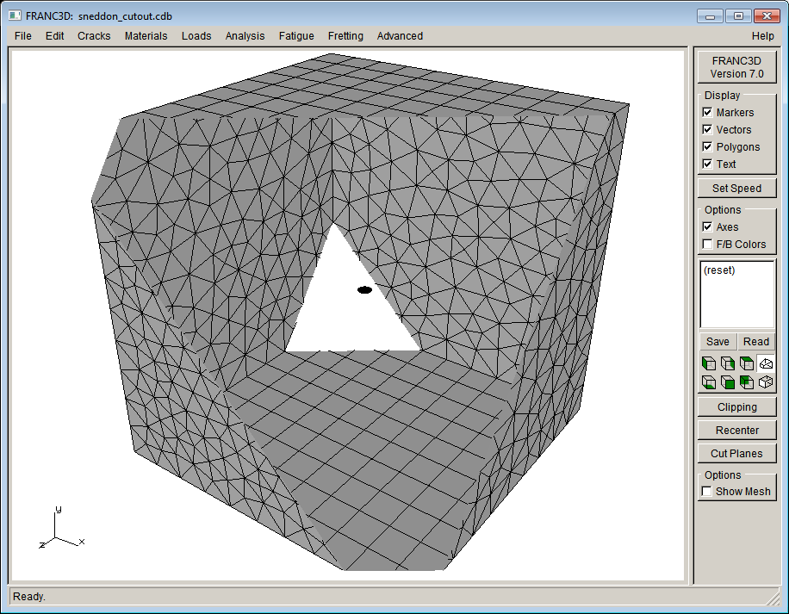
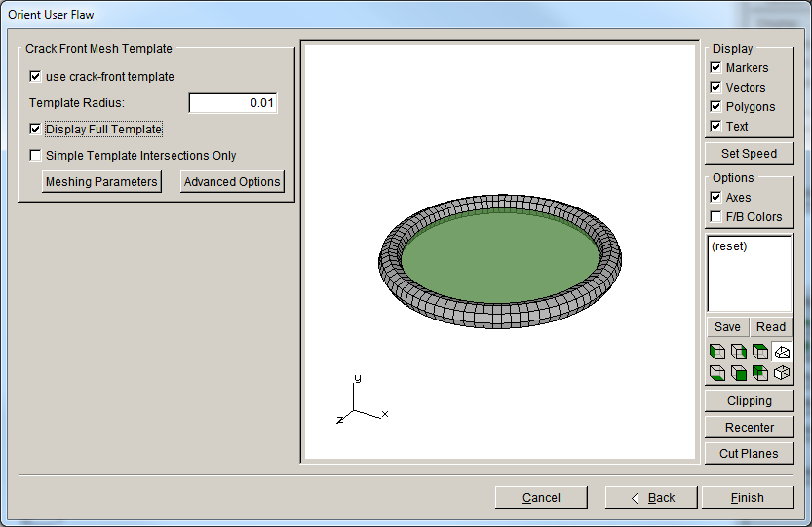
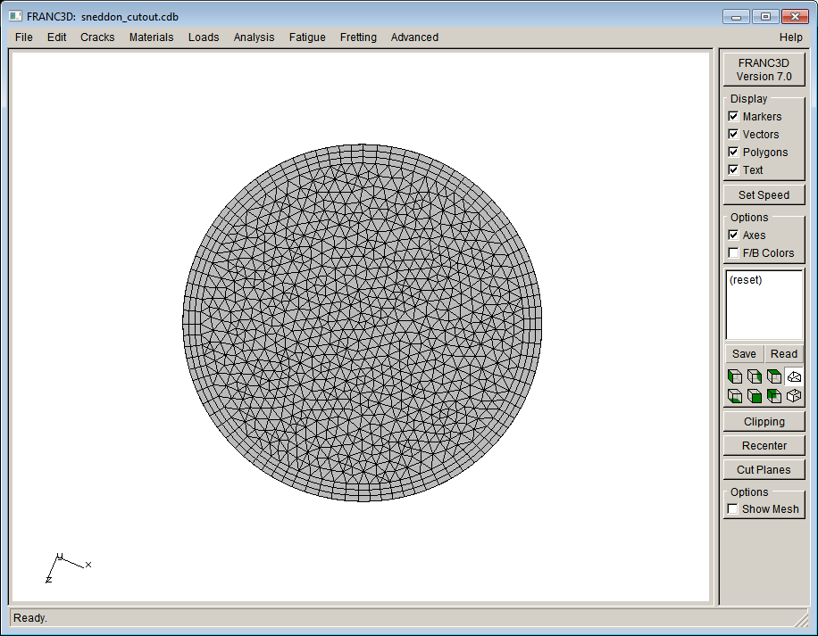
M-Integral SIFs: Embedded Penny Crack
Template Cross-Section
Default crack front mesh gives 0.2% error.

Slide 51
M-Integral SIFs: Penny Surface Crack
~2% difference max
The Raju-Newman solution is known to be slightly inaccurate near the free surface.

Slide 52
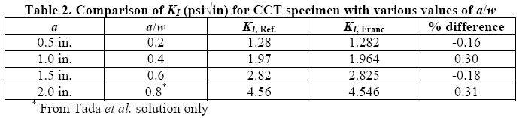
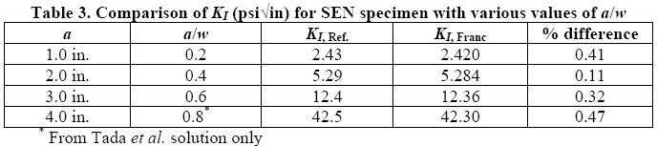
Independent Mode I SIF Verification
Analyses performed by Dawn Phillips NASA Langley Research Center using FRANC3D Version 5.0
CCT
SEN
Users are strongly encouraged to do their own benchmark/validations.
52

