Slide 1
FRANC3D Training Workshop: Part IX
April - 2018
Drs. Paul “Wash” Wawrzynek, Bruce Carter, Tony Ingraffea and Omar Ibrahim
Fracture Analysis
Consultants, Inc.

Slide 2
Workshop Agenda
Part I: Introduction to Fracture Mechanics Analysis
Part II: Introduction to FRANC3D
Part III: Finite Element (FE) Model Import
Part IV: Crack Insertion
Part V: Static Crack Analysis & SIF Computation
Part VI: SIFs from FE
Part VII: Crack Growth
Part VIII: Multiple/Variable DOF Approach to Fatigue Life
Part IX: SIF History & Fatigue Life
Part X: FRANC3D Files, Session Log, Command Line and Python Interface
Part XI: Miscellaneous

Slide 3
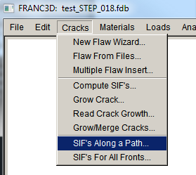
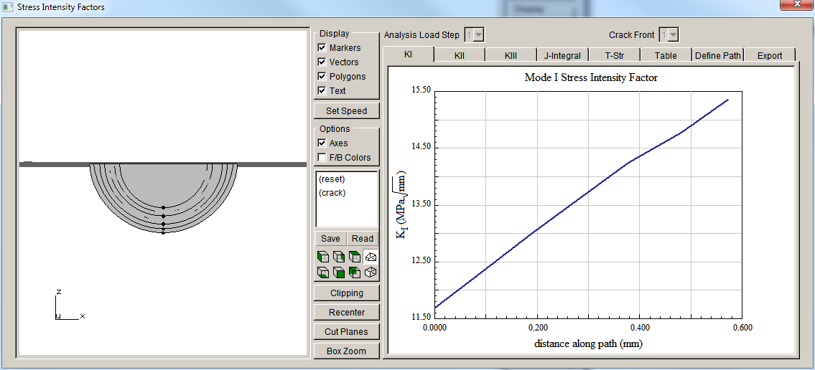
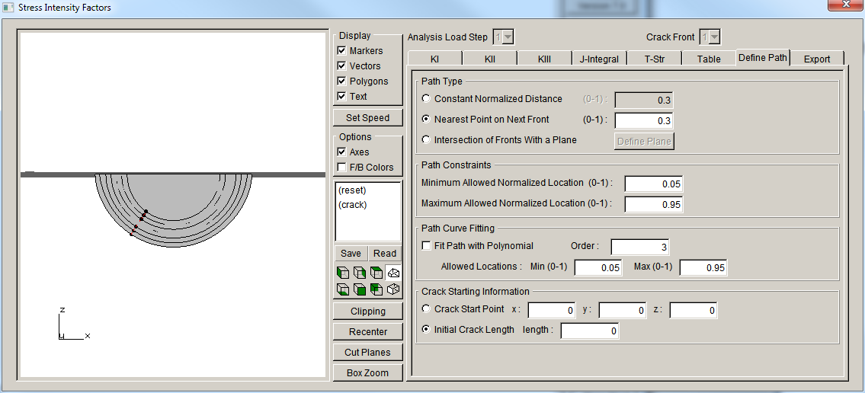
SIF History
Re-Open FRANC3D restart file if needed
from Cracks menu, choose SIFs Along a Path
Define different paths to look at SIF variations.

Slide 4
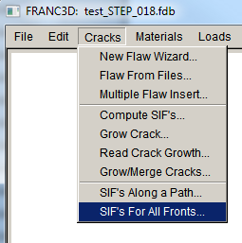
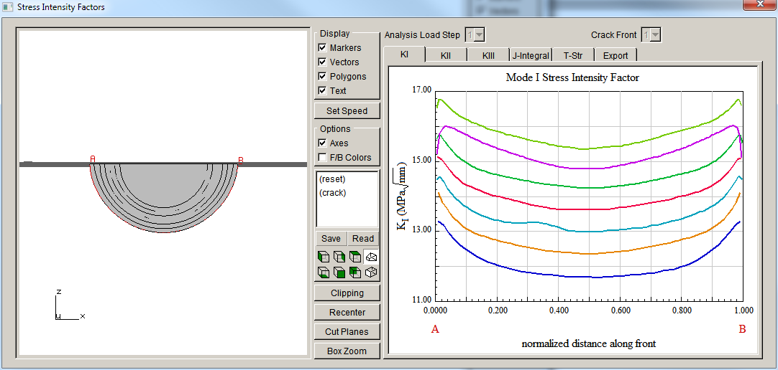
SIF History
from Cracks menu, choose SIFs For All Fronts
Plot (and export) SIF values along all crack fronts.

Slide 5
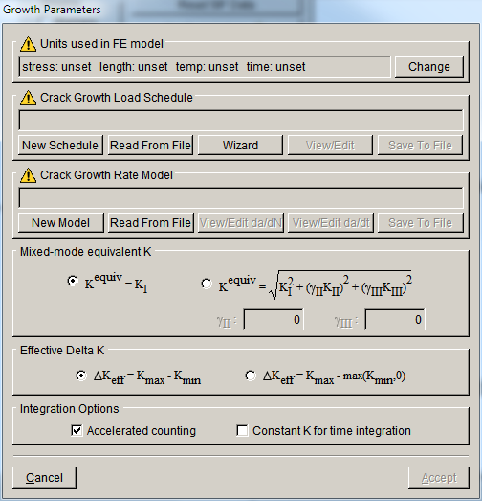
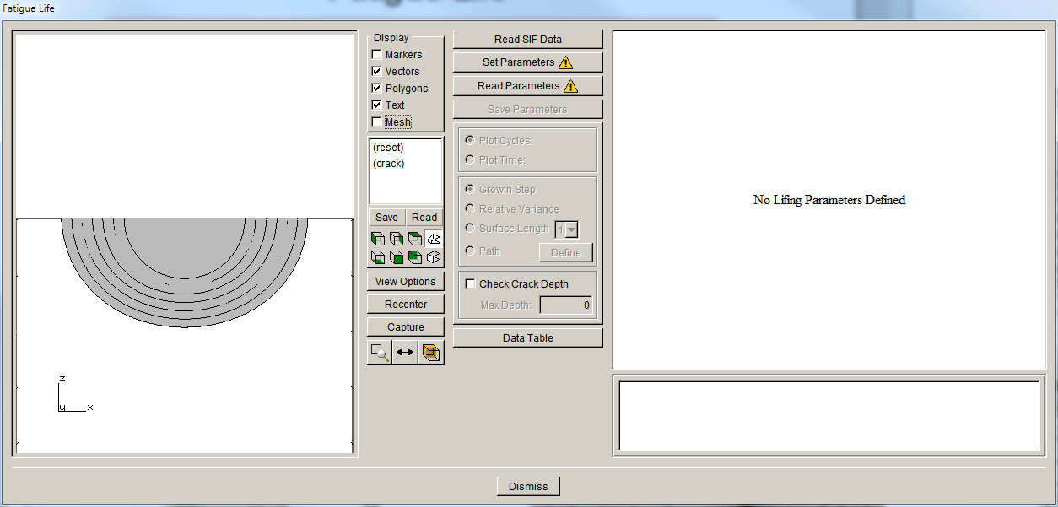
Fatigue Life
Re-Open FRANC3D restart file if needed
from Fatigue menu, choose Fatigue Life Predictions
If crack growth was done using a fatigue option, the model & data is passed into the fatigue life module.
For quasi-static growth, parameters must be set.

Slide 6
Demo: SIF History and Fatigue Life

